Slide 1
Sexual imagery and morality in the works of Anthony Hecht
Jacob Moose

Slide 2
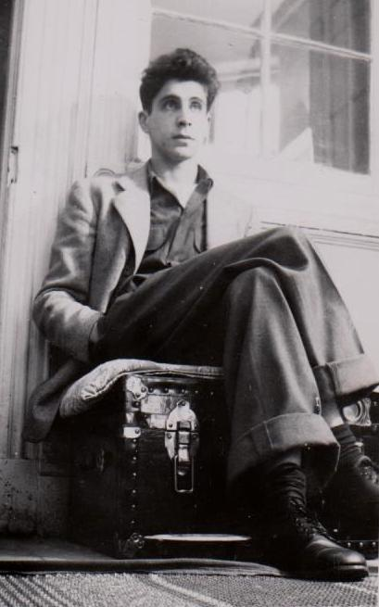
Who is Anthony Hecht?
Born January 16, 1923 (Manhattan, NY)
Grew up in a Small Jewish Family
Upper-Middle Class/Upper Class
1940 – 1943: Bard College
Interrupted by World War II
1943 – 1946: Enlists to serve in WWII
U.S. Army Infantry
European Front (1945)
Japan (1946)
Discharged March 12, 1946
1946 – 1950: Continues education
1951-1993: University Career as Professor/Poet/Critic
Dies October 20, 2004 (Washington, D.C.)
Anthony Hecht, 1947
Notes:
Anthony Hecht was born in New York City to

Slide 3
Horrors of World war ii: Liberation of Flossenbürg (1945)
“Flossenbürg was an annex of Buchenwald. It was both an extermination camp and a slave-labour camp. […] Prisoners were dying at the rate of 500 a day from typhus. […] The place, the suffering, the prisoners' accounts were beyond comprehension. For years after I would wake shrieking.”
(Anthony Hecht in Conversation with Philip Hoy 26)

Slide 4
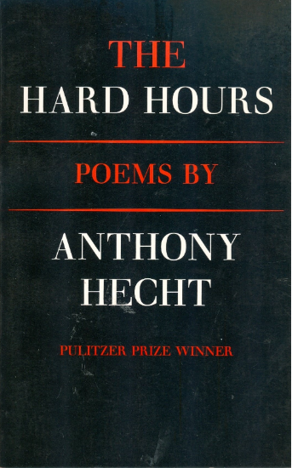
war & Holocaust poetry
“More Light! More Light!”(from The Hard Hours)
One of his most anthologized poems
Other Notable War Poems:
“The Book of Yolek”
“An Overview
“Still Life”
Rites and Ceremonies
Notes:
In terms of content, Hecht has generally been perceived within War and Holocaust Framework
Emphasis on Hecht’s juxtaposition of “Evil” vs “Good” when it comes to the world (especially WWII)
A prime example is “More Light! More Light!” Which tells a narrative about two Jewish characters buried alive’
Or “The Book of Yolek”, a sestina about a boy named Yolek who is taken from home and forced into concentration camp

Slide 5
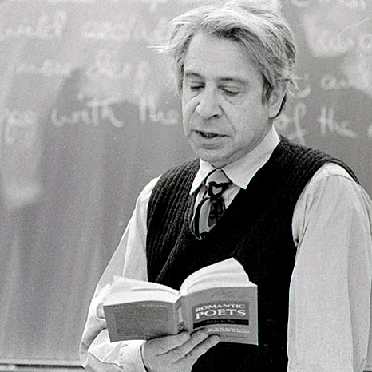
Other Poetic interests
Shakespeare and the Bible
Ekphrastic Poems
Literary Criticism and Translation
Notes:
Shakespeare and the Bible
“A Love for Four Voices” (A Midsummer’s Night Dream)
“The Feast of Stephen”
Ekphrastic and Art Poems
"Matisse: Blue Interior With Two Girls-1947“
The Gehenna Florilegium
Other: Literary Criticism and Translation
Obbligati
Aeschylus’ Seven Against Thebes

Slide 6
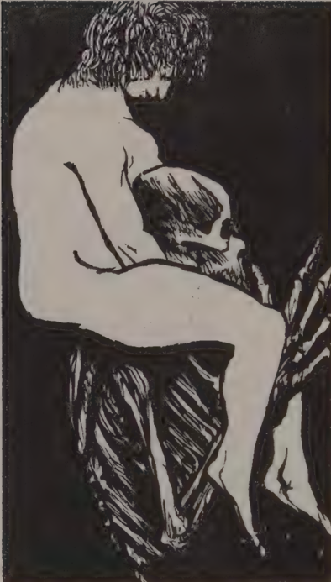
Approaching sexual imagery in Hecht’s work
Sexual Imagery and Violence: What does violent sexual imagery in Hecht’s work reveal about post-WWII perceptions of sexuality?
Sexual Imagery and Ethics: Does Hecht imply there is a “good” or “healthy” form of sexuality in his poetry? How does this relate to the sexual norms of his time?
“War Poet?”: How has WWII morality frameworks and late 20th-century formalist movements influenced the reception (or neglect) of Hecht’s sexual imagery?
Death the Whore
Baskin, 1995

Slide 7
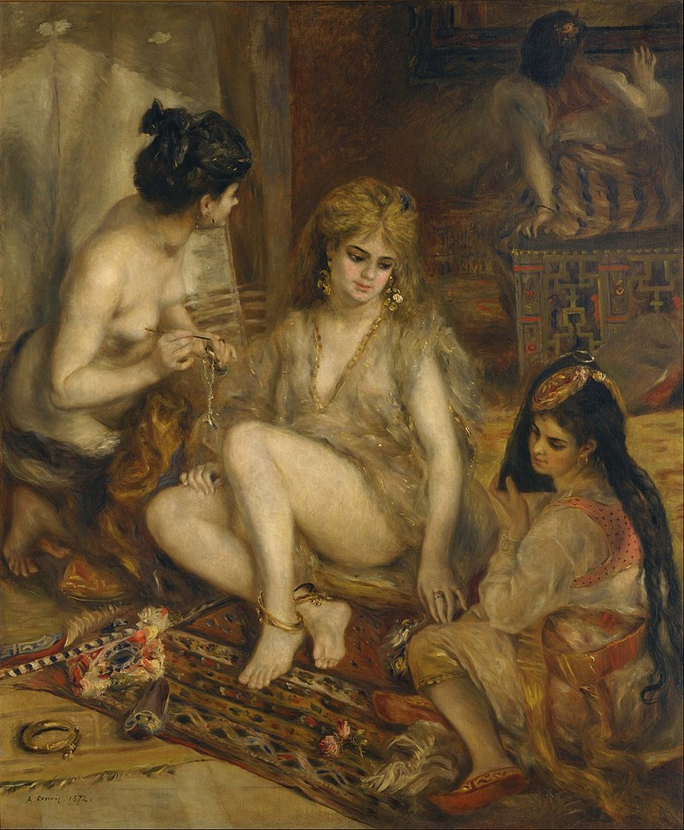
“The Deodand”
Ekphrastic poem based on Renoir’s Parisian Women in Algerian Costume (1872)
____________________________________________________________
Swathed in exotic finery, in loose silks,
Gauzy organzas with metallic threads,
Intricate Arab vests, brass ornaments
At wrist and ankle, those small sexual fetters,
Tight little silver chains, and bangled gold […]
In the final months of the Algerian war
They captured a very young French Legionnaire.
They shaved his head, decked him in a blonde wig,
Carmined his lips grotesquely, fitted him out
With long, theatrical false eyelashes
And a bright, loose-fitting skirt of calico,
And cut off all the fingers of both hands.
He had to eat from a fork held by his captors.
Thus costumed, he was taken from town to town, Encampment to encampment, on a leash,
And forced to beg for his food with a special verse
Sung to a popular show tune of those days […]
Parisian Women in Algerian Costume (The Harem)
Renoir, 1872
Notes:
Deodand: “A thing forfeited or to be given to God; spec. in Eng. Law, a personal chattel which, having been the immediate occasion of the death of a human being, was given as an expiatory offering, i.e., forfeited to the Crown to be applied to pious uses.”
___________________________________________________________

Slide 8
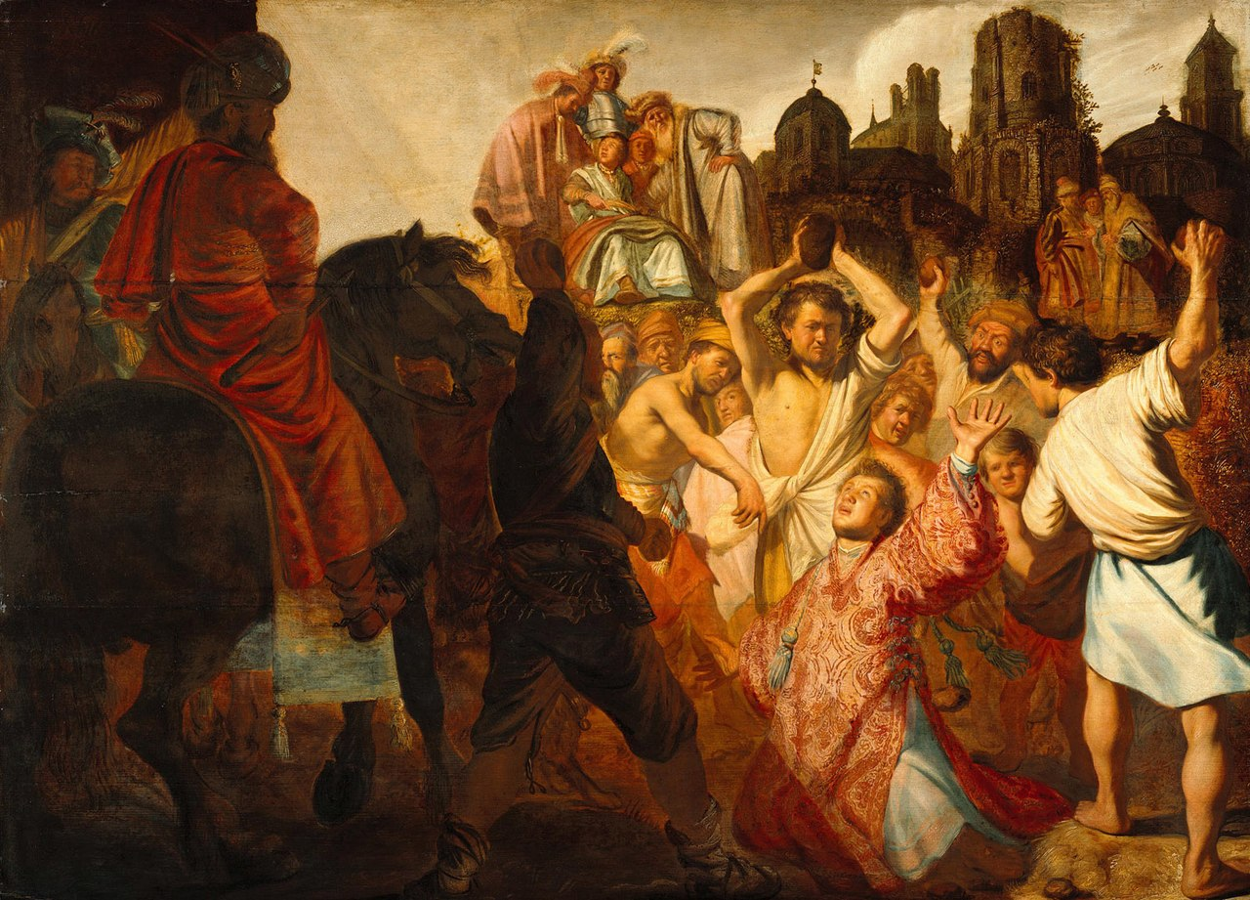
“The feast of Stephen”
(Non-ekphrastic poem, painting as reference)
_____________________________________________________
I
The coltish horseplay of the locker room, […]
Boys for the first time frankly eye each other,
Inspect each others’ bodies at close range,
And what they see is not so much another
As a strange, possible version of themselves,
And all the sparring dance, adrenal life,
Tense, jubilant nimbleness, is but a vague,
Busy, unfocused ballet of self-love.
IV
He watches sharply these superbly tanned
Figures with a swimmer’s chest and shoulders,
A miler’s thighs, with their self-conscious grace,
And in between their sleek, converging bodies,
Brilliantly oiled and burnished by the sun,
He catches a brief glimpse of bloodied hair
And hears an unintelligible prayer.
The Stoning of Saint Stephen
Rembrandt, 1625
Notes:
Out in the rippled heat of a neighbor’s field,
In the kilowatts of noon, they’ve got one cornered. […]
They go to arm themselves at the dry-stone wall,
Having flung down their wet and salty garments
At the feet of a young man whose name is Saul.

Slide 9
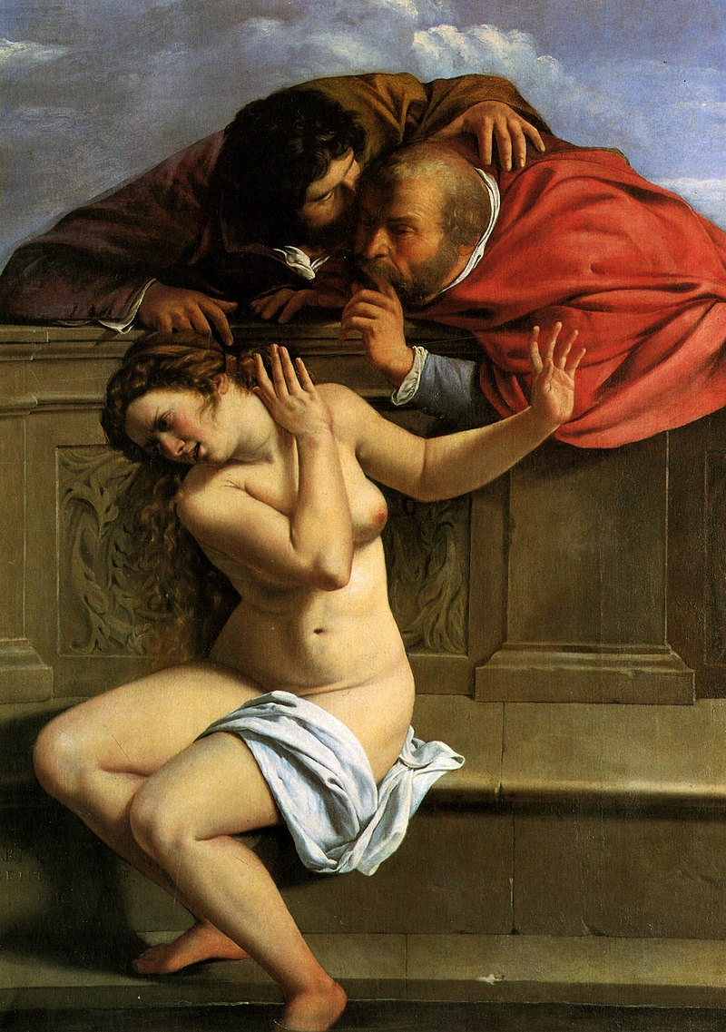
“Elders”
(Non-ekphrastic poem, painting as reference)
___________________________________________________________
As a boy he was awkward, pimpled, unpopular,
Disdained by girls, avoided by other boys,
An acned solitary. But bold and spectacular
The lubricious dreams that such a one enjoys. […]
And so it went year by tormented year,
His yearnings snarled in some tight, muddled sensation
Of violence […]
When he was old he encountered someone else
Enslaved by similar dreams and forbidden seethings, […]
Who brought him where they both could observe bathing
In innocent calm voluptuous Susanna,
Delicate, and a quarter of his age,
Her flesh as white and wonderful as manna,
Exciting them both to desire engorged with rage.
Susanna and the Elders
Gentileschi, 1610
Notes:
Susanna and the Elders
chapter 13 of the Book of Daniel

Slide 10
reception by new formalists (1980’s – 2000’s)
“In the 1980s, a group of young poets, enthusiastic about the resources of traditional prosody, began to link formal prosody with conservative political ideology. These were the New Formalists.”
(Cambridge 70-71)
Movement developed against free verse poetry (such as Lowell’s Life Studies (1959) and Ginsberg’s Howl (1954))
“’Confessionalism’ [was] frequently cited as the literary sign of the corrupt culture of the 1960s” (Cambridge 74)
___________________________________

Slide 11
Questions?

